Slide 1

Computer Systems Fundamentals
H175 34
Lecture 2
Numbers in base 16

Slide 2





Why Base 16?
Last week, we saw that a base of 10 is a natural counting mechanism for humans.
But a base of 16 appears a lot in human society too.
This is because of the unique properties of the number 16.
It is an exact square - 4², or 2⁴.

Slide 3
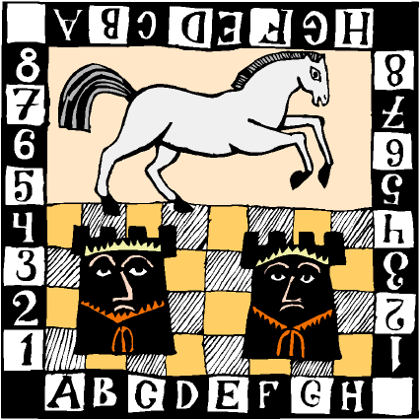

The Uniqueness of 16…
The first four odd numbers added – 1+3+5+7 equals 16.
A compass rose is divided into 16 points.
Chessboards have 16 black and 16 white pieces.
They are divided into four quadrants of 16 squares each.

Slide 4

The Uniqueness of 16…
Bookbinders use a standard format of sixteenmo, where the paper is divided into sixteen leaves.
Caterpillars usually have 16 legs! (But only 6 when they become butterflies).
Pre-decimal Imperial weights
and measures used
16 ounces to a pound.

Slide 5
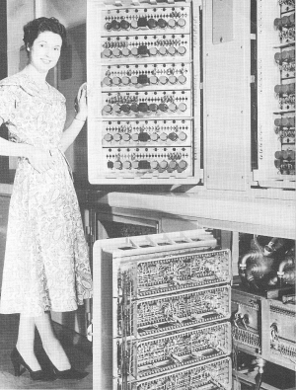
Programming In 16
We saw last week that computers can only store and manipulate data in a binary base – base 2.
The earliest computer programs were written in binary by highly trained mathematicians. They were, however, highly prone to errors….

Slide 6
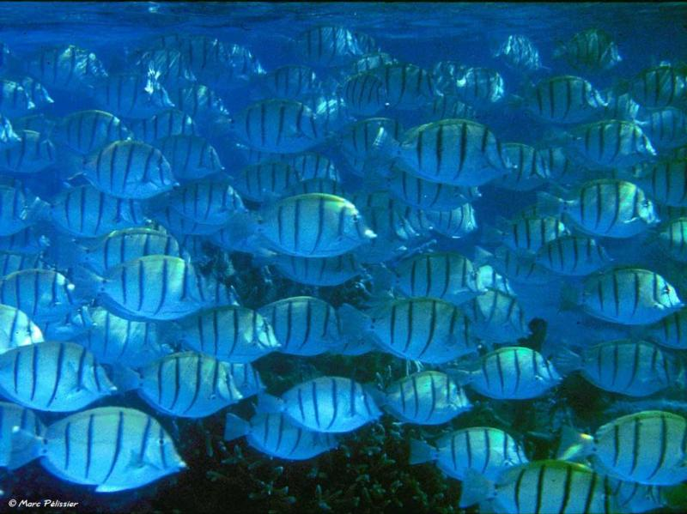
… because the human eye becomes very confused when dealing with large groups of similar looking objects!

Slide 7

Converting 2s to…..
A method had to be found to “convert” large binary numbers to something that humans find easier to read and manipulate.
As base 2 does not convert to base 10 very easily, we use base 16 – hexadecimal – instead.

Slide 8
Each Hexadecimal column uses a power of 16.
^{Column Number} | ⁵ | ⁴ | ³ | ² | ¹
^{Power} | 16⁴ | 16³ | 16² | 16¹ | 16⁰
^{Value} | 65536 | 4096 | 256 | 16 | 1
But we only have 10 unique symbols using the digits 0 to 9.
So to make up 16 symbols, we use the letters A – F as well.

Slide 9
A hexadecimal number will look like this….
^{Column Number} | ⁵ | ⁴ | ³ | ² | ¹
^{Power} | 16⁴ | 16³ | 16² | 16¹ | 16⁰
^{Value} | 65536 | 4096 | 256 | 16 | 1
^{Hex Number} | 1 | 8 | A | 0 | 9
The above number is worth 100873 in a decimal base.
We get this by multiplying and adding…..
(1x65536) + (8x4096) + (10x256) + (0x16) + 9

Slide 10
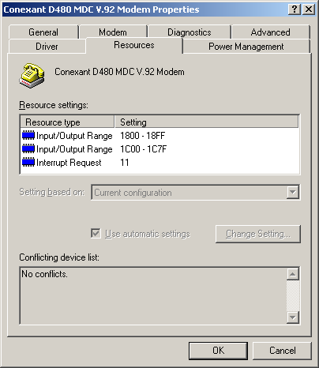
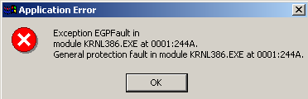
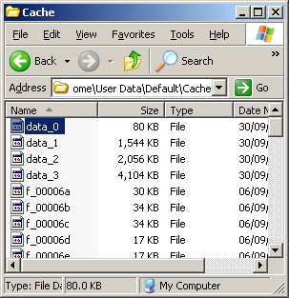
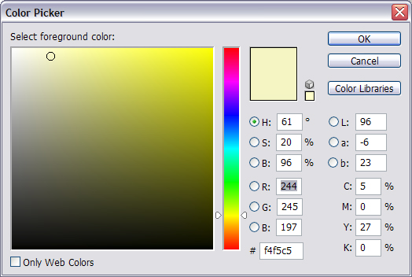
Some examples of hexadecimal numbers….

Slide 11
You will be required to convert numbers in a binary base (base 2) to hexadecimal (base 16). The question will tell you how many bits of storage to use.
Example – convert this number to hexadecimal using 16 bit storage.
1 | 0 | 0 | 1 | 1 | 1 | 1 | 0 | 0 | 0 | 0 | 0 | 1 | 0 | 1 | 0
1 0 0 1 | 1 1 1 0 | 0 0 1 1 | 1 0 1 0
Always begin by dividing the binary number into “nibbles” (groups of 4) working from right to left.

Slide 12

Each nibble can only hold a value of between 0 and 15.
Replace each nibble with the equivalent hexadecimal digit….
1 0 0 1 | 1 1 1 0 | 0 0 1 1 | 1 0 1 0
9 | 14 or E | 3 | 10 or A
…and 16 binary digits have been replaced with 4 hexadecimal ones!

Slide 13

It works the other way round…
…expand each hexadecimal digit to four binary ones….
E | 7 | F | 4 | C | 0 | 1 | B
1110 | 0111 | 1111 | 0100 | 1100 | 0000 | 0001 | 1011
…and your 8-digit hexadecimal number has become a 32-bit binary one!

Slide 14

Decimal to Hex
Sometimes you will have to convert directly from decimal to hex….
…we can use the “Columns” process that we looked at last week with the binary conversion.

Slide 15

The Number 17862 converted…
^{Column Number} | ⁵ | ⁴ | ³ | ² | ¹
^{Power} | 16⁴ | 16³ | 16² | 16¹ | 16⁰
^{Value} | 65536 | 4096 | 256 | 16 | 1
^{Hex Number} | 0 | 4 | 5 | C | 6
We have 0 “lots of 65536….
4 “lots” of 4096 are 16384, leaving 1478 still to allocate
5 “lots” of 256 are 1280, leaving 198 to go
12 “lots” of 16 are 192, leaving 6
Remember you can have up to 15 in each column!

Slide 16
To convert from hex to decimal, we use the “hexadecimal columns” method to multiply and add.
^{Column Number} | ⁴ | ³ | ² | ¹
^{Power} | 16³ | 16² | 16¹ | 16⁰
^{Value} | 4096 | 256 | 16 | 1
^{Hex Number} | 5 | F | 7 | B
5 x 4096 = 20480
F or 15 x 256 = 3840
7 x 16 = 112
B or 11 x 1 = 11
20480 + 3840 + 112 + 11 = 24443

Slide 17
You can convert from hex – binary – decimal if you prefer….
DAF3h
1101 1010 1111 0011₂
56051₁₀
….and back again from decimal – binary – hex….
57072₁₀
1101 1110 1111 0000₂
DEFOh
…because they all mean exactly the same value, it’s just expressed in different ways.
Note that sometimes a lowercase ‘h’ is used to mean “hexadecimal base”.

Slide 18
Convert the following….
F0₁₆ to binary
271₁₆ to binary
295A₁₆ to binary
1011 to hex
1101 0111 to hex
1010 1100 to hex
1111 0000₂
0010 0111 0001₂
0010 1001 0101 1010₂
B₁₆
D7₁₆
AC₁₆

Slide 19
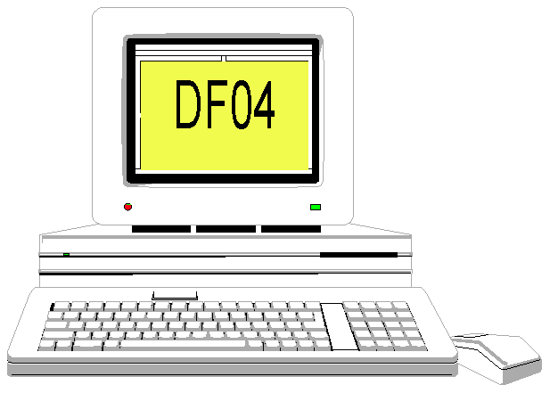
It is important to remember that computers do not actually store things in hexadecimal. Everything is stored in binary!
1101 1111 0000 0100
Computers just display things in hexadecimal to make life easier for the human audience.

Slide 20
If you forget the column headings when working in 16s, they are easy to work out.
Start with the binary columns....
...and divide them into nibbles of 4 (remember to always work from right to left!)
2¹⁶ | 2¹⁵ | 2¹⁴ | 2¹³ | 2¹² | 2¹¹ | 2¹⁰ | 2⁹ | 2⁸ | 2⁷ | 2⁶ | 2⁵ | 2⁴ | 2³ | 2² | 2¹ | 2⁰
65536 | 32768 | 16384 | 8192 | 4096 | 2048 | 1024 | 512 | 256 | 128 | 64 | 32 | 16 | 8 | 4 | 2 | 1
2¹⁶ | 2¹⁵ | 2¹⁴ | 2¹³ | 2¹² | 2¹¹ | 2¹⁰ | 2⁹ | 2⁸ | 2⁷ | 2⁶ | 2⁵ | 2⁴ | 2³ | 2² | 2¹ | 2⁰
65536 | 32768 | 16384 | 8192 | 4096 | 2048 | 1024 | 512 | 256 | 128 | 64 | 32 | 16 | 8 | 4 | 2 | 1

Slide 21
...and you should see how the base-16 columns line up with the base-2 ones!
2¹⁶ | 2¹⁵ | 2¹⁴ | 2¹³ | 2¹² | 2¹¹ | 2¹⁰ | 2⁹ | 2⁸ | 2⁷ | 2⁶ | 2⁵ | 2⁴ | 2³ | 2² | 2¹ | 2⁰
65536 | 32768 | 16384 | 8192 | 4096 | 2048 | 1024 | 512 | 256 | 128 | 64 | 32 | 16 | 8 | 4 | 2 | 1
65536 | 4096 |  |  |  | 256 |  |  |  | 16 |  |  |  | 1
16⁴ | 16³ |  |  |  | 16² |  |  |  | 16¹ |  |  |  | 16⁰

Slide 22
Some more for you to try…..
FACE₁₆ in binary?
And Decimal?
1111 | 1010 | 1100 | 1110
64206
0101 0000 1101 0000 1111 1111₂ in hex?
5 | 0 | D | 0 | F | F

Slide 23

Any Questions?

Slide 24

Summary
Although computers store and manipulate values in binary, they usually display them in hexadecimal format.
Each group of four bits corresponds to one hexadecimal digit.
Hexadecimal digits run from 0 -9 then A – F.
The value of each hexadecimal digit rises by a power of 16 as the columns move to the left.
Hexadecimal values are usually followed by a lowercase “h”, or a small ₁₆.

Slide 25

Credits
Manchester MkII © University of Manchester
Convict Fish © Marc Palissier 2002
Hex examples © Chrissie Nyssen
All other graphics © Focus Multimedia with open licence, unless stated
All other contents © Aberdeen College 2010-12

